Slide 1

Impact Of Covid-19 On India
Data Analyst Project
By- Rahul Bisht

Slide 2
Table of contents
01
02
03
04
05
Objective
Insight
Dashboard
Challenges Faced
Conclusion

Slide 3
Project Objectives Are As Follows:
Cleaning dataset is the preliminary step as the dataset contains huge amount data.
After cleaning dataset next step to extract meaningful insight from dataset.
Use of Power Bi for data visualizations.
Last step create interactive Dashboard.

Slide 4
INSIGHTS

Slide 5
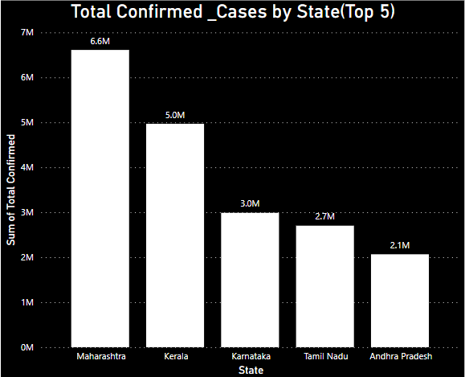
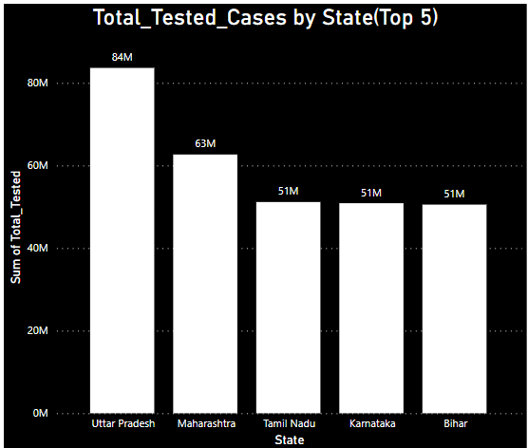
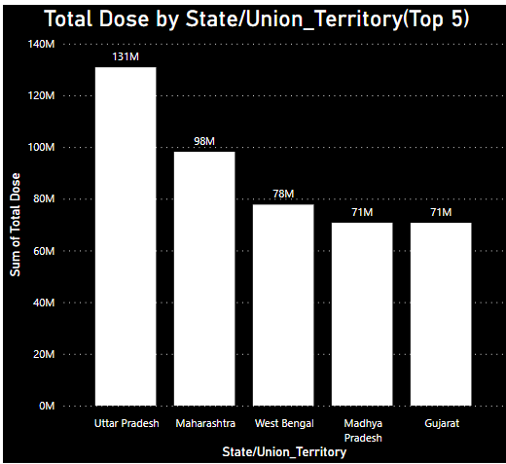
Impact and Prevention

Slide 6
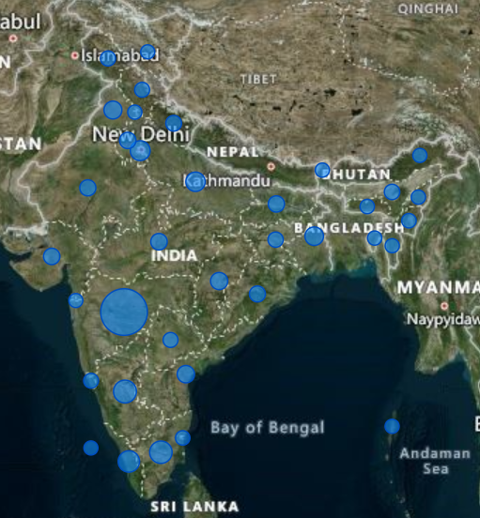
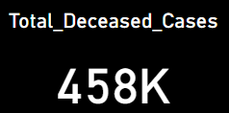
Topography Of Total Deceased People
As looking to the topography it shows central and southern part of India has affected more as compare to other part

Slide 7
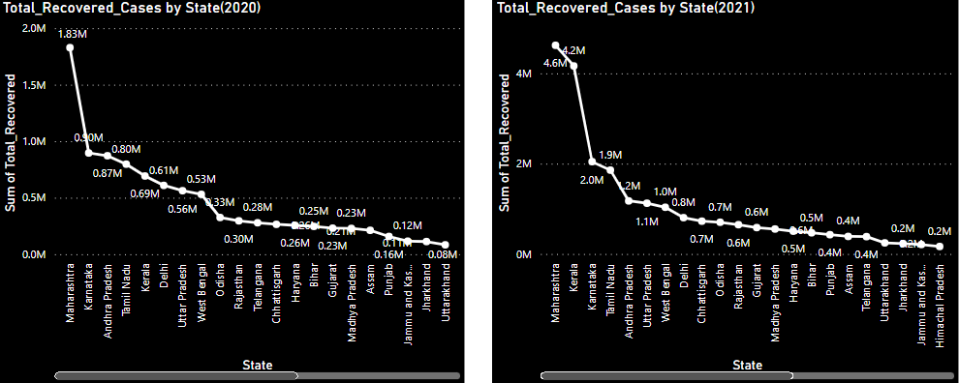
Year Wise Recover Cases
Neptune
Neptune is the farthest planet from the Sun and the fourth-largest in the Solar System
Mercury
Mercury is the closest planet to the Sun and also the smallest one in the Solar System
Mars
Mars is a cold place. It’s full of iron oxide dust, which gives the planet its reddish cast

Slide 8
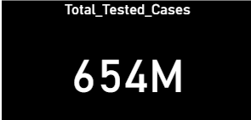
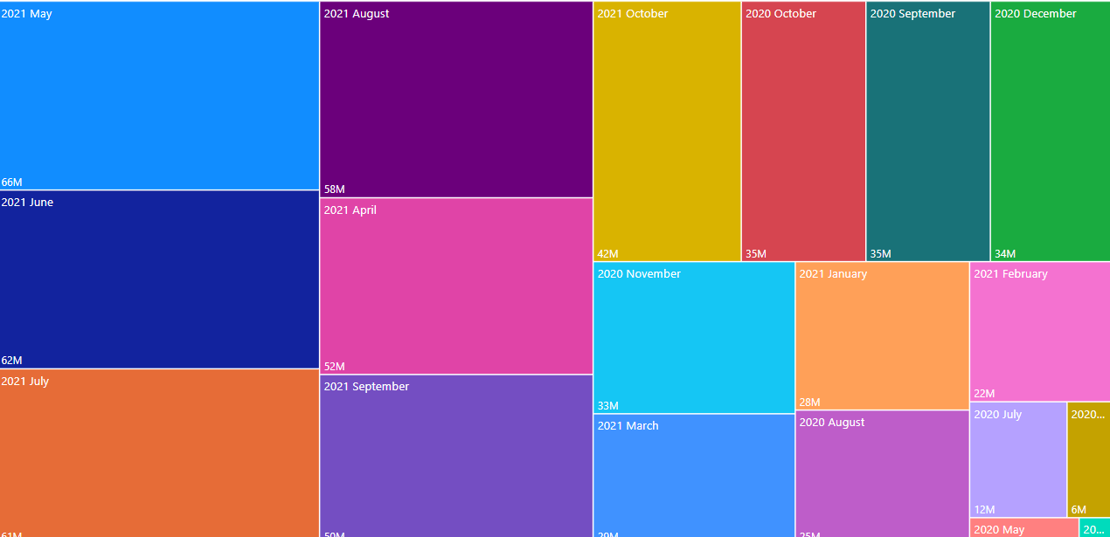
Total Tested Case By Year And Month
Mars
Venus
Mars is actually a very cold place
Venus is the second planet from the Sun
Saturn
Jupiter
It’s composed of hydrogen and helium
Jupiter is the biggest planet of them all

Slide 9

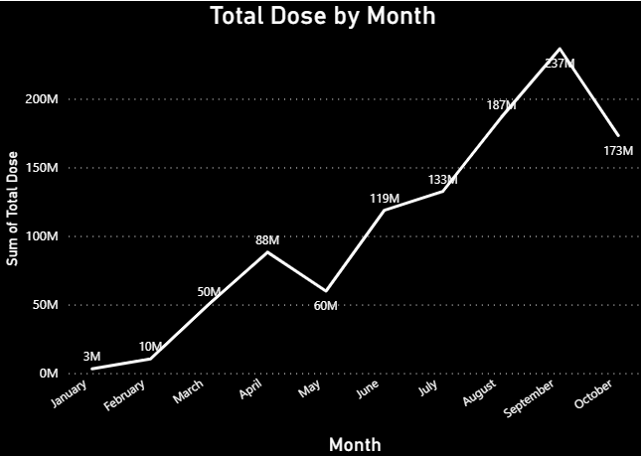
Vaccination Monthly Data

Slide 10
Dashboard

Slide 11
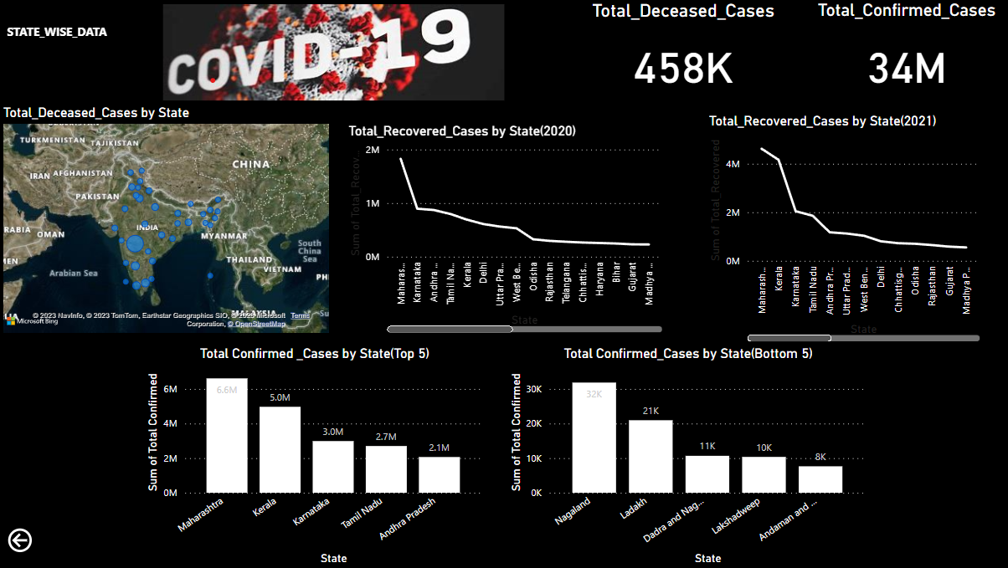
State Wise Dashboard

Slide 12
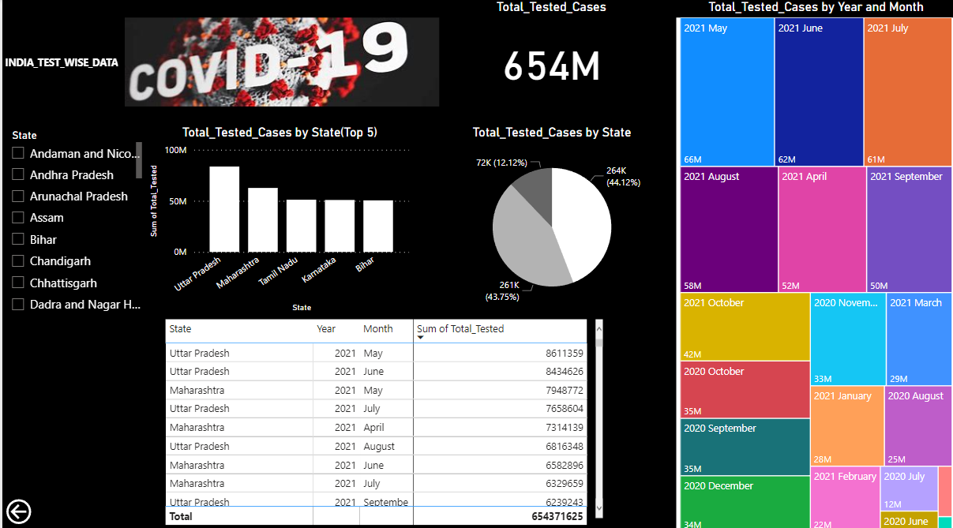
India Test Wise Dashboard

Slide 13
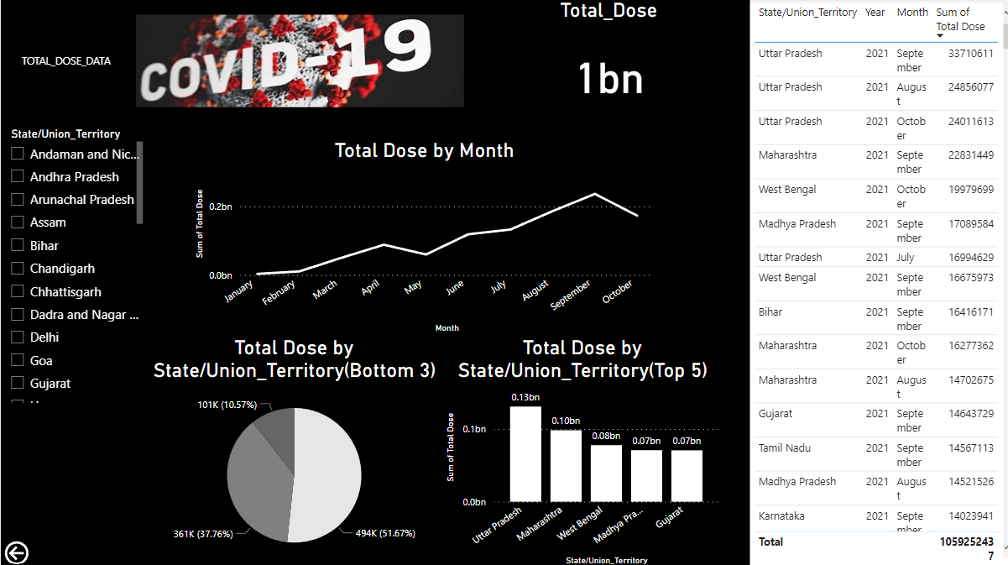
Vaccination Dashboard

Slide 14
Challenges Faced
Dataset cleaning is one of the biggest challenge as data consist many blank data, duplicate data etc.
Extract insight from dataset using power bi tool also difficult part because power bi tool is new tool to use. .

Slide 15
Conclusions
UP has maximum number of covid test-84million and maximum vaccination-131million.
Maharashtra has Maximum number of confirmed cases- 6.6 million.
As looking to the topography it shows central and southern part of India has affected more as compare to other part.
As we compare two year 2020 and year 2021,impact of covid -19 in year 2021 has doubled with respect to total deceased people and slightly more in confirmed cases.
May , June , July of year 2021 has happened maximum number of covid test around 60 million a month.

